Slide 1
Accessing Access
Access Tutorial
January 29, 201
Marie-Eve Leclerc, Msc Student
Marie-Eve.Leclerc@ubc.ca

Slide 2
Learning objective
To gain a general understanding of Microsoft Access
To gain a general understanding of FPS-ATLAS data structure
To understand how Microsoft Access and FPS-ATLAS are connected

Slide 3
What is Microsoft Access?
Database manager
Populated with interconnected tables that allow for data analysis
Queries manipulate data
Join tables
Filter tables
Update data
Make new tables
Can be automated with Macros
Notes:
Who here has used Microsoft Access before? Heard of it?
Database manager, meaning you can organize huge datasets into multiple individual tables which are all interconnected allowing you to perform queries on your dataset

Slide 4
How does Access organize data?
Data is organized into tables
Access gives the ability to interconnect all of the tables
Notes:
Tables on Left, some are populated some are not
Open Polygon Table
Every polygon has descriptive information, stand group, age area etc.
I mentioned earlier all of the tables were connected…we saw stand group ID and zone ID were both in the polygon table but also existed as their own table…
Open up relations

Slide 5
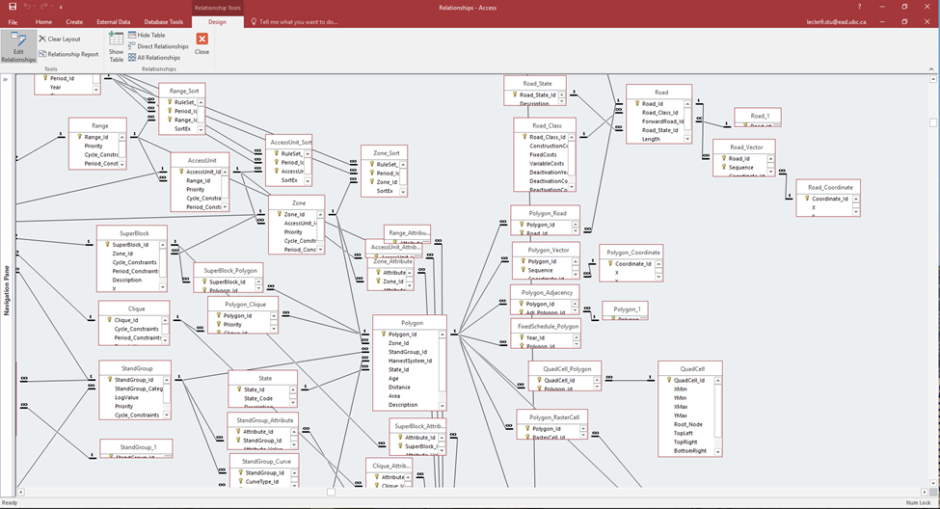
How are Access tables connected?
Primary key: One or more fields (column) that exists in every table and “links” tables together
Every table is connected via a “Primary key”
Unique identifier
No duplicates
Not to be changed
Little key symbol, or “1”
Notes:
E.G from data…
Every table needs one primary key, can’t have one table not connected to anything else
By “Connected” I mean they share the same column name, not data
If primary key is deleted, make sure you understand what tables it was connected to and how they are all interlinked

Slide 6
How are Access tables connected?
Foreign key: One or more fields (column) in a table that refers to a primary key
Can have duplicates
Little infinity symbol
Notes:
Polygon Table is table you will be looking at the most because it has each individual polygon linked to a stand group, age, area and a description. This table was taken and converted from a GIS shapefile.

Slide 7
What is FPS-ATLAS?
Spatial and visual representation of long-term timber harvest schedule
Area-based timber management
Notes:
Do we all know what FPS ATLAS is?
Crude description: long term harvest modelling software
Right now you have a database but you will want to make adjustments to make your new scenarios
Big changes, quick and painless in Access, but if you’re looking for spatial constraints, easier in FPS ATLAS
Can make changes directly in FPS ATLAS but you will quickly discover it is tedious work and there are easier/quicker ways of doing things

Slide 8
How does Access relate to FPS ATLAS?
Access is the backbone of FPS ATLAS
FPS ATLAS is a visual and spatial representation of your Access database
Any changes made in Access will be seen in FPS ATLAS
Notes:
Do we all know what FPS ATLAS is?
Crude description: long term harvest modelling software
Right now you have a database but you will want to make adjustments to make your new scenarios
Big changes, quick and painless in Access, but if you’re looking for spatial constraints, easier in FPS ATLAS
Can make changes directly in FPS ATLAS but you will quickly discover it is tedious work and there are easier/quicker ways of doing things

Slide 9
Helpful Analysis Tools in Access for FPS ATLAS
Descriptive Statistics
Queries
Update existing tables
Appending tables
Notes:
I am going to show you 3 cool things in Access that will help you in your scenario making
You can get away without using them but are life-changing

Slide 10
Descriptive Statistics
Open a table
Then select “Totals”
Notes:
Can anyone tell me what are descriptive statistics
Summary data to show what is currently in the stand
Open table

Slide 11
Helpful Analysis Tools in Access for FPS ATLAS
Descriptive Statistics
Queries
Update existing tables
Appending tables
Notes:
I am going to show you 3 cool things in Access that will help you in your scenario making
You can get away without using them but are life-changing

Slide 12
How is data structured in FPS ATLAS?
Depending on different management objectives, you will want to group your dataset to assign different constraints
Hierarchical data structure
Ranges
Access units
Zones
Cliques
Polygons
Notes:
Think of it like an umbrella, Ranges being most encompassing
This applies to how you will apply and manage constraints to specific areas on your landbase
You specifically will be looking at zones, cliques and polygons
e.g. Zone will be assigning areas as THLB and NTHLB to assign a no harvest constraint on NTHLB
Within those areas, you have different stand types and thus different harvesting frequency or types. Cliques delineating different groups of stand types to be harvested a certain
Zones constraint overrides clique constraints

Slide 13
Queries – Update a table – Defining a Zone
Example: Assign deciduous, not sufficiently restocked (NSR) and non-productive (NP) stand groups to Non-Timber Harvest Landbase (NTHLB)
Would you assign this as a zone or as a clique?
Notes:
FIRST THINGS FIRST CREATE A NEW FILE

Slide 14
Queries – Update a table
Define our Zones
Notes:
FIRST THINGS FIRST CREATE A NEW FILE

Slide 15
Queries – Update a table
Open up the Query Tab
Notes:
FIRST THINGS FIRST CREATE A NEW FILE

Slide 16
Queries – Update a table
Select the table that holds the data you would like to update
Since Polygon table contains both “Stand group” and “Zone”
Notes:
FIRST THINGS FIRST CREATE A NEW FILE

Slide 17
Queries – Update a table
Select “Update” option
Notes:
FIRST THINGS FIRST CREATE A NEW FILE

Slide 18
Queries – Update a table
There are 4 main rows to build a query:
Field: Column of data you want to look up
Table: Data from the table you want to look up
Update to: If you wish to make changes to a specific field, in this row you specify to what you want it to change to
Criteria: Specific criteria that the data will only be processed for those particular cases
Notes:
FIRST THINGS FIRST CREATE A NEW FILE

Slide 19
Queries – Update a table
Example: Example: Assign deciduous, not sufficiently restocked (NSR) and non-productive (NP) stand groups to Non-Timber Harvest Landbase (NTHLB)
What this query is saying is StandGroups 3,4 and 5 will be updated to zone 2 in the Zone_Id column and updated to NTHLB in the Description column
Notes:
FIRST THINGS FIRST CREATE A NEW FILE

Slide 20
Queries – Append a table – Making a Clique
Example: Combine stand groups based on different harvesting types
Would you assign this as a zone or as a clique?
Notes:
FIRST THINGS FIRST CREATE A NEW FILE

Slide 21
Queries – Append a table – Making a Clique
Define our Cliques
Clique 1 = Moose Habitat (Productive Fir and deciduous stands)
Clique 2 = Dead pine (Low site productivity pine stands)
Clique 3 = Regen (Low site productivity Fir)
Notes:
FIRST THINGS FIRST CREATE A NEW FILE

Slide 22
Queries – Append a table – Making a Clique
Open up the Query Tab
Notes:
FIRST THINGS FIRST CREATE A NEW FILE

Slide 23
Queries – Append a table – Making a Clique
Select the table that holds the data you would like to append
Select Polygon table because it has every polygon defined
Notes:
FIRST THINGS FIRST CREATE A NEW FILE

Slide 24
Queries – Append a table – Making a Clique
Open up the Query Tab
Notes:
FIRST THINGS FIRST CREATE A NEW FILE

Slide 25
Queries – Append a table – Making a Clique
Append polygon_ID to Polygon_Clique table
We want to define the clique_Id by Polygon_Id
Notes:
Open up relationship table to show connection

Slide 26
Queries – Append a table – Making a Clique
There are 4 main rows to build a query:
Field: Column of data you want to populate Polygon_clique table
Table: Data from the table that will populate Polygon_clique table
Append to: The field in the table in which you want to append the data
Criteria: Specific criteria that the data will only be processed for those particular cases
Notes:
Open up relationship table to show connection

Slide 27
Queries – Append a table – Making a Clique
Example: Combine stand groups based on different harvesting types
What the query is saying is to append the Polygon_Id information from the polygon table to the Polygon_Id column in the Polygon_Clique table
Expr1: 1 = Assign all Priority to “1”
Expr2: IF statement breaking up our StandGroups into our 3 previously defined Clique_Id
Notes:
Have to populate all the columns.

Slide 28
Queries – Append a table – Making a Clique
Example: Combine stand groups based on previously defined cliques
IF Statement in SQL (coding language): IIf (expression, truepart, falsepart)
IIF NOT A TYPO
Expression: IIF([StandGroup_Id]=12,2,1)
If StandGroup_Id is equal to 12, then assign it a value of 2, if not, a value of 1
For this example because we have 3 values, use a nested IF statement
IIf([StandGroup_Id]=23,1,IIf([StandGroup_Id]=13,1,IIf([StandGroup_Id]=42,2,3)))
If StandGroup_Id is equal to 23, then assign it to clique 1, If StandGroup_Id is equal to 13, then assign it to clique 1, if StandGroup_Id is equal to 42, then assign it to clique 2, if not, assign all remaining polygons to clique 3
Notes:
Have to populate all the columns.

